Slide 1
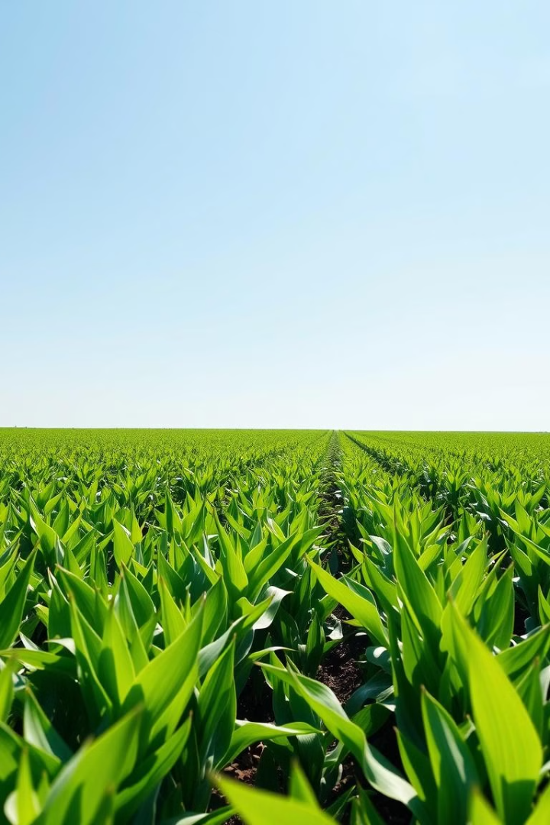

Plant Disease Detection: A Convolutional Neural Network Approach
Plant diseases pose a significant challenge to the agricultural sector, leading to considerable yield losses and economic setbacks. Early and accurate detection of these diseases is crucial for timely intervention. This project leverages Convolutional Neural Networks (CNNs) to build an image-based plant disease detection system capable of identifying and classifying diseases across multiple crops.
by Maanya Gupta

Slide 2

Introduction
The agricultural industry faces significant challenges due to crop diseases, which result in substantial yield losses. Early detection and classification of these diseases can help mitigate these losses, allowing for timely intervention. In this project, we utilize Convolutional Neural Networks (CNNs) to develop an image-based plant disease detection system. The system is trained on images of diseased and healthy plants, with the goal of accurately identifying the type of disease from an image of the plant leaf.
1
Challenge
2
Solution
Crop diseases lead to significant yield losses in agriculture.
Early detection and classification of diseases can mitigate losses.
3
Approach
Utilizing Convolutional Neural Networks (CNNs) to develop an image-based plant disease detection system.

Slide 3
Related Works
Previous projects in the field of plant disease detection have predominantly utilized Convolutional Neural Networks due to their effectiveness in image classification. For instance, one study employed a simple CNN model to detect diseases in tomato plants with a dataset of 10,000 images, achieving an accuracy of 85%. Another project used transfer learning with the ResNet model to detect grape and apple diseases but did not generalize well to other crops. Although these studies have shown promising results, they are often limited in scope, focusing on a single crop or disease type, which reduces their applicability in diverse agricultural environments.
Previous Studies
Limitations
Utilized CNNs for plant disease detection.
Limited scope, focusing on single crops or disease types.
Simple CNN model for tomato plant disease detection.
Transfer learning with ResNet model for grape and apple diseases.

Slide 4
Project Objectives
The objective of this project is to develop a scalable, accurate, and robust plant disease detection model using CNNs. Unlike previous studies, this project aims to:
Include a diverse dataset covering multiple crops and disease types to improve generalization.
Experiment with various CNN architectures to find an optimal model for accuracy and efficiency.
Implement data augmentation techniques to improve model robustness in real-world scenarios.
Objective
Description
Scalability
The model should be able to handle large datasets and diverse plant types.
Accuracy
The model should accurately identify and classify plant diseases.
Robustness
The model should be resilient to variations in lighting, image quality, and other real-world factors.

Slide 5

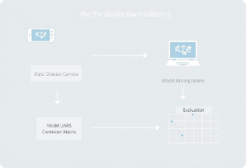
Methodology
The methodology employed in this project involves the following steps:
1
Data Collection
The project uses the publicly available PlantVillage dataset, which includes images of leaves affected by various diseases across different crops.
2
Model Design
Three distinct CNN models were trained and tested: a basic CNN, a VGG16-based model, and a ResNet50-based model.
3
Training and Evaluation
Each model was trained with 80% of the dataset and evaluated on the remaining 20% for validation. Metrics such as accuracy, precision, and recall were used to assess model performance.

Slide 6

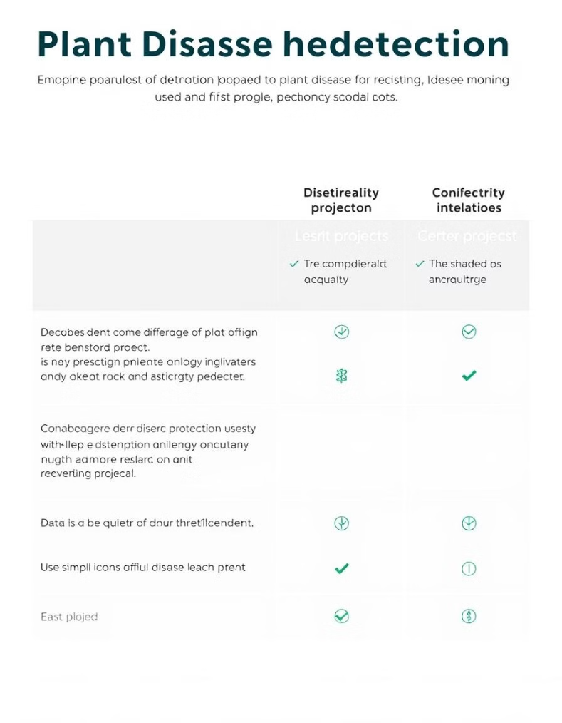
Comparison with Existing Work
This project differs from existing work in several key ways:
Broader Dataset
Multiple Model Architectures
Unlike other projects that focus on a single type of crop or disease, our project covers 38 different classes, including various crops and diseases. This improves the model’s ability to generalize across multiple plants.
We trained three separate models, each with unique architectures, to determine the best approach for plant disease classification.
Augmentation and Regularization
To enhance model robustness, we applied extensive data augmentation and regularization techniques, which were not extensively utilized in similar projects.

Slide 7




Conclusion
This project successfully demonstrated the potential of CNN-based models for accurately classifying plant diseases across a diverse range of crops. The findings indicate that complex architectures like ResNet50 yield higher accuracy compared to basic CNN models, making them more suitable for real-world deployment. Future work could involve incorporating additional data from various sources or testing the model on real-time images from the field to further enhance applicability.
Success
CNN-based models effectively classify plant diseases.
Accuracy
ResNet50 architecture outperforms basic CNN models.
Future Work
Incorporating additional data and real-time testing.

Slide 8






Future Scope
This project lays a strong foundation for advanced plant disease detection systems but leaves room for future enhancements:
Real-Time Deployment
Integrating the model into mobile or IoT devices for real-time disease detection in fields.
Expanded Dataset
Incorporating data from various sources, including real-world images from diverse geographic regions, to improve model performance and applicability.
Multilingual Support
Developing user-friendly applications with support for multiple languages to cater to a broader audience, including non-English-speaking farmers.
Advanced Architectures
Experimenting with more advanced models like EfficientNet or Vision Transformers to further boost accuracy and computational efficiency.
Early Detection
Extending the system to detect early signs of disease from microscopic or partially visible symptoms.
Integration with Crop Management Systems
Connecting the detection system with advisory platforms to recommend treatment methods, fertilizers, or pesticides based on the diagnosed disease.

